Slide 1

Network Systems Module 2
Final assignment Nedap University

Slide 2

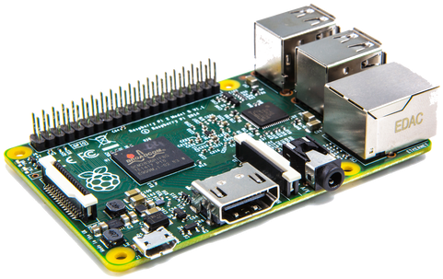




Assignment
Nedap University Module 2
Develop a file storage application for a Raspberry PI
Develop a client application for a laptop
Implement a reliable upload & download protocol for files
Restrictions
Individual assignment
You must use UDP, TCP not allowed
Must be able to deal with unreliable networks (packet loss)

Slide 3
Planning
Nedap University Module 2
Kick-off
Thursday 11-04 10:00
Work on assignment
2 weeks
Deadline
Thursday 25-04 12:00
Presentation and Tournament
Friday 26-04 10:00
Evaluation
Friday 26-04
Coaches 13:00
Individual 15:00
Report & code

Slide 4

Tournament
Nedap University Module 2
Functional demonstration of your solution
Multiple rounds
Network will be more unreliable every round
Student with fastest file transfer wins
Grand prize!

Slide 5
Report & Presentation
Nedap University Module 2
Report
High level overview
Explain protocol
Explain parameters
Statistics
Presentation
Max. 10 minutes
No demo needed
What are you proud of?
What could be improved?

Slide 6

Recommendations
Nedap University Module 2
Setup your PI today
Plan ahead
Have fun!

Slide 7
Logo animation – Heritage Blue

